Slide 1
Seasonal Variation of Dust Activity in the Middle East and its influence on Aircraft engine
Alain Gasco 10114980
Aiman Wahizam 10161890

Slide 2
Introduction and Aims
In-service Aircraft for a Global Observing System (IAGOS) used
Study the seasonal variation of dust activity in the Middle East
Linking this dust activity to the aircraft engine wear

Slide 3
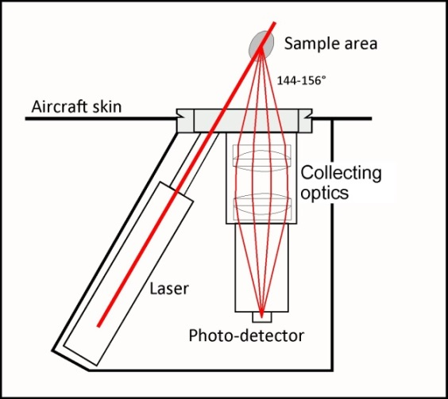
Backscatter Cloud Probe
Laser wavelength 658 nm
Collects data every 4 seconds
Particles incident on the laser causes backscattering
Uses Mie theory to approximate particle diameters

Slide 4
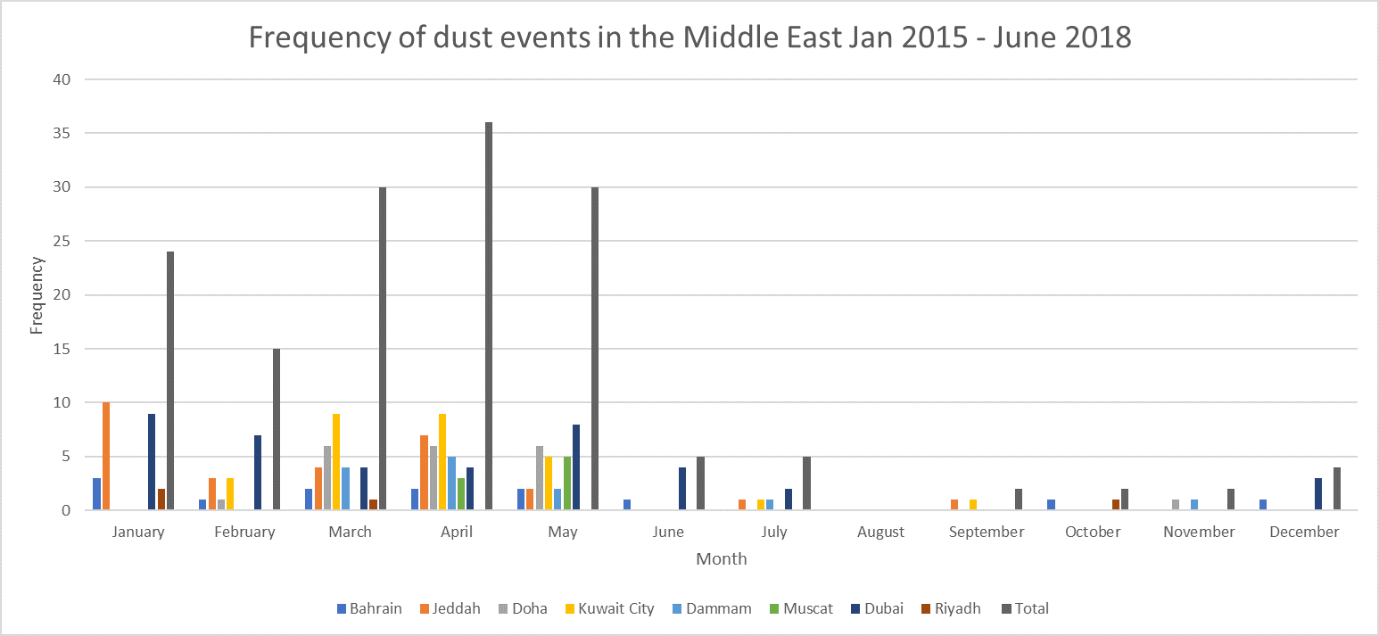
Results: Middle East

Slide 5
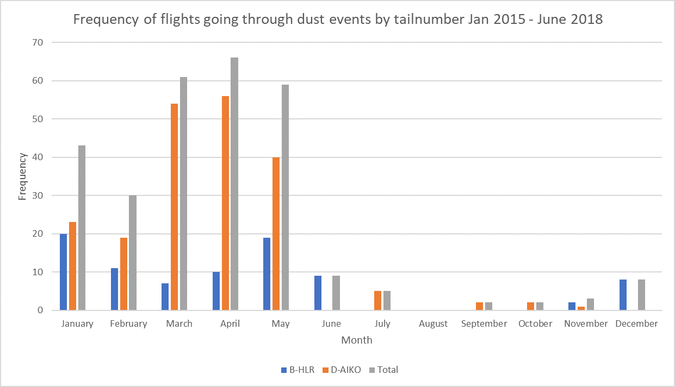
Results: Middle East

Slide 6
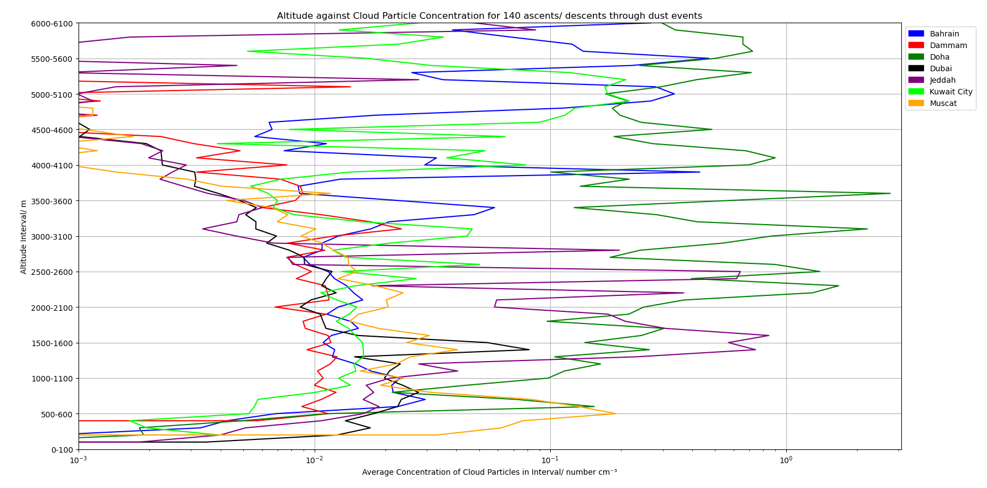
Results: Vertical Profiles

Slide 7
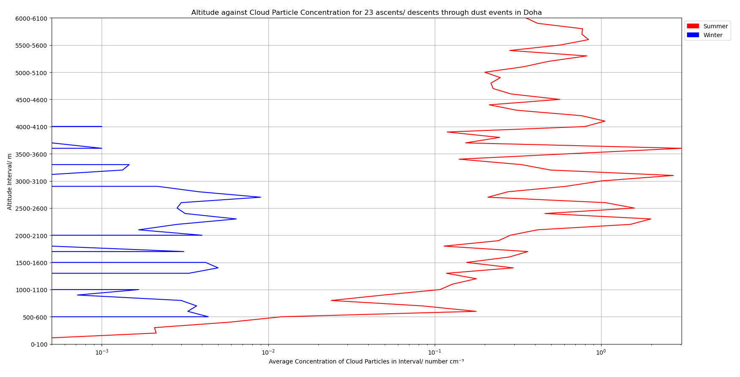
Results: Vertical Profile of Doha, Qatar

Slide 8
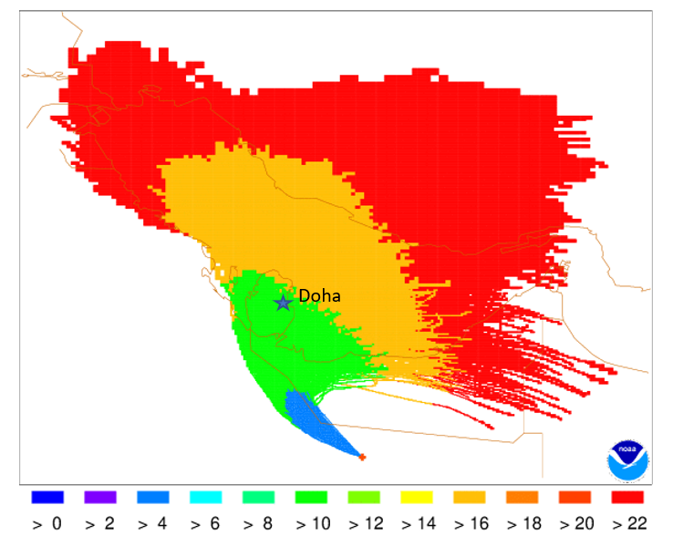
Results: 9th February Doha Dust Storm
Origin of dust was from the south-east, likely the Saudi Arabian desert

Slide 9
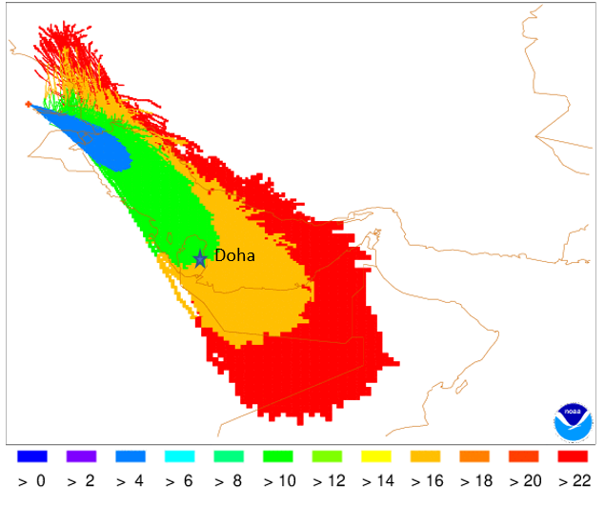
Results: 23rd June Doha Dust Storm
Origin of dust from the North-west, likely from the Iraqi desert

Slide 10
Implications for Aviation Safety
Ingestion of dust has an effect on engine wear, but how much?
The linking of mineralogy to frequency of dust storms is important

Slide 11
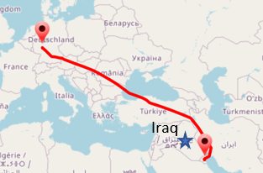
Limitations of the Data I
Civilian flight restriction over Iraqi airspace due to ongoing military intervention in Iraq and Syria
Noticeably fewer flight profiles in the winter months compared to the summer months
Passenger aircraft will not fly during extreme dust events out of safety for the aircraft
Passenger aircraft will also deliberately fly around clouds to reduce turbulence

Slide 12
Limitations of the Data II
A lot of the flight profiles flew through clear skies, 140 out of 1497 flight profiles had non-zero particle concentration
BCP uses Mie theory which assumes particles are perfect spheres
Lack of Relative Humidity (RH) and H₂O gas data
Particles of size 5 – 75 microns were only detected

Slide 13
Conclusion
It can be seen that on average, the concentration of dust during the summer is greater than that in the winter
The accumulation of dust and minerals can be sufficient to ground an aircraft if left unchecked

